Slide 1
Practical Solutions to Toxicology Issues in DUI Cases
Brianna Peterson, PhD, DABFT
Toxicology Laboratory Division
Washington State Patrol

Slide 2
Toxicology Topics
Cannabis and Driving Impairment
Pharmacology
Driving studies
Other relevant marijuana literature
I-502
Zolpidem
Miscellaneous

Slide 3
Cannabis and Driving Impairment

Slide 4
Absorption
Smoking
Rapid and efficient
Factors for bioavailability - how many puffs, duration and volume of inhalation, spacing between puffs, user experience
Effects felt within seconds, peak concentration reached in minutes
Oral
Slower absorption with lower bioavailability
First pass metabolism
Notes:
30% of THC destroyed by pyrolysis

Slide 5
Distribution
Large volume of distribution
Highly protein bound in plasma
High lipid solubility
Drug is stored in fat and slowly released
Long terminal half life (days)

Slide 6
Metabolism/Elimination
Active metabolite: 11-OH-THC
Peak concentrations 13.5 min after start of smoking
Detection time similar to THC (hours)
Inactive metabolite: Carboxy-THC
Rises slowly and plateaus around 4 hours
Can be detected for days post-use

Slide 7
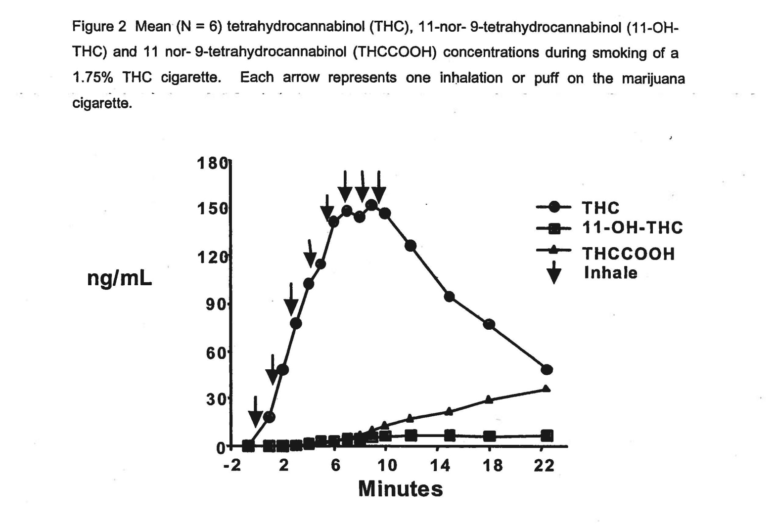
Pharmacokinetics
Figure by Huestis

Slide 8
Duration of Effects
Effects from smoking are felt within minutes
Effects reach their peak in 10-30 minutes
Most users experience a “high” that last about 2-3 hours
Most behavioral and physiological effects last 3-6 hours after drug use
Researchers have shown that some residual effects may last up to 24 hours
Psychomotor impairment can persist after the perceived high has dissipated

Slide 9
Psychological Effects
Euphoria
Relaxation
Altered time and space perception
Lack of concentration
Impaired memory/learning
Mood changes
Disorientation
Sense of well-being
Drowsiness
Notes:
Mood change – panic or paranoid

Slide 10
Physiological effects
Tachycardia
Reddened conjuctiva
Dry mouth and throat
Increased appetite
Vasodilation
Bronchodilation
Decreased respiratory rate

Slide 11
DRE Profile
HGN- not present
VGN- not present
Lack of convergence- present
Pupil size- normal to dilated
Reaction to light- normal to slow
Pulse- elevated
Blood pressure- elevated
Temperature- elevated to normal

Slide 12
2007-2009 DRE cases
THC/THC-COOH (n=101)
93% male
78% Caucasian
Average age: 24 (range: 16-70)
THC-COOH only (n=147)
79% male
84% Caucasian
Average age: 27 (range: 14-61)
Not impaired (n=17)
76% male
94% caucasian
Average age: 38 (range: 19-74)

Slide 13
Summary
 | Cannabis Indicator | THC/THC-COOH | THC-COOH | Not impaired
HGN | None | 9% | 11% | 6%
VGN | None | 0 | 2% | 0
Lack of convergence | Present | 66% | 47% | 6%
Pupil size | Normal to dilated | 55% | 55% | 15%
Reaction to light | Normal | 76% | 77% | 82%
Pulse | Elevated | 57% | 57% | 25%
Blood pressure (systolic/diastolic) | Elevated | 45%/22% | 45%/25% | 41%/12%
Body temperature | Normal | 73% | 87% | 77%
Notes:
HGN, only 5/11 greater than 2 clues for carboxy; 6/13 for THC
2 cases VGN carboxy- one could not perform hgn due to eyes being weird, other had 6/6 hgn – bucl, a/n run

Slide 14
Summary
 | THC/THC-COOH | THC-COOH | Not Impaired
Bloodshot eyes | 86% | 81% | 24%
Eyelid Tremors | 81% | 81% | 38%
2/8 clues on WAT | 72% | 81% | 25%
2/4 clues on OLS | 46% | 57% | 31%
Rebound Dilation | 43% | 41% | 6%
Notes:
OLS – carboxy (57%), THC (46%), not impaired (31%)
40% rebound dilation for both.

Slide 15
Other signs of use
Odor of marijuana
Debris in mouth
Green coating on the tongue/raised taste buds
Bloodshot eyes
Eyelid and body tremors
Relaxed inhibitions
Poor field sobriety test performance
WAT- balance, focus and heel to toe
Romberg balance- swaying, body tremors
Finger to nose- inability to touch tip to tip
OLS- time distortion

Slide 16
Drug Interactions
Marijuana combined with stimulants (cocaine, amphetamines, etc.) can lead to increased hypertension, tachycardia and possible cardiotoxicity
Depressants (Benzodiazepines, barbiturates, muscle relaxants, etc.) can increase drowsiness and CNS depression
Marijuana used in combination with ethanol leads to additive effects
Marijuana and ethanol use makes the user more likely to be a traffic safety risk than when consumed alone

Slide 17
Cannabis and Driving
Principle effects:
Divided attention tasks
Vigilance
Tracking decisions
Increased reaction times
Perception
Impaired time and distance estimation
Decreased car handling performance
Lateral travel
A driver’s ability to react to unexpected events can be impaired by cannabis use

Slide 18
Driving Studies
Marijuana, Alcohol and Actual Driving Performance
Ramaekers et al, Hum Psychopharmacol 2000;15(7): 551-558
Road tracking and car following tests
Dosed with marijuana +/- alcohol
Effected reactions times, SDLP, time out of lane, deviation of headway
Marijuana and Actual Driving Performance Executive Summary
Robbe and O’Hanlon, NHTSA November 1993
Impairment observed after subjective high and physical indicators decreased
All THC doses significantly effect SDLP

Slide 19
THC and SFSTs
40 subjects dosed with 1.74 or 2.93% THC
SFSTS administered 5, 55, and 105 min post dose
Driving simulator task performed 30 and 80 min post dose
Performance on SFSTs allowed identification of impaired driving 80% of the time
OLS is best indicator
Balance most effected clue for WAT
Caveats: High false positive rate, driving not deemed impaired at time 1 (30 min)
The relationship between performance on the standardised field sobriety tests, driving performance and the level of THC in blood. Papafotiou et al, Forensic Sci Intl 155 (2005); 172-178
Notes:
Subjective feelings of high are present in the first hour – subjects may compensate because they feel high – perform better on driving simulator. Do not feel subjective effects of high at time 2, and therefore showed impairment on driving simulator because they did not compensate

Slide 20
THC and SFSTs continued
20 heavy cannabis users dosed 400 µg/kg THC
SFSTs performed 2 hrs post dose
SFSTS mildly sensitive to THC impairment; 4 users showed impairment with THC compared to placebo
A placebo-controlled study to assess SFSTs performance during alcohol and cannabis intoxication in heavy cannabis users and accuracy of point of collection testing devices for detecting THC in oral fluid. Bosker et al, Psychopharmacology (2012) 223:439-446

Slide 21
Residual THC in blood
Heavy (>1 joint/day), moderate (≤ 1 joint/day) and light (<1 joint/week) users
Measured residual concentrations of THC in SERUM, 48 hrs post-use
User group | Total (positive) | Range (ng/mL)
Heavy | 16 (8) | 1.2 – 6.4
Moderate | 15 (6) | 1.0 – 2.6
Light | 6 (1) | 1.4
Cannabinoid concentrations in spot serum samples 24-48 hrs after discontinuation of cannabis smoking
Skopp and Potsch. JAT 2008, 32; 160-164

Slide 22
Residual THC in blood continued
30 chronic daily users
Blood drawn for 33 days during monitored sustained abstinence
Day 1: Highest THC concentration: 2.9 ng/mL (59% had THC ≥ 1ng/mL)
All subjects had THC ≤ 1 ng/mL within 7 days
Impact of prolonged cannabinoid excretion in chronic daily cannabis smokers’ blood on per se drugged driving laws. Bergamaschi et al. Clinical Chemistry (2013)59:3;519-526

Slide 23
Tolerance and chronic marijuana users
10 heavy chronic cannabis users dosed with 6.8% THC cigarette
No significant effect on critical tracking task
Divided attention task: no significant effect on reaction time, tracking, and control losses
Decreased number of correct signal detections
21 heavy cannabis users dosed with 400 µg/kg THC cigarette
No effect on critical tracking, motor impulsivity and cognition
Divided attention tasks: increased reaction times, increased number of control losses, decreased number of correct signal detections
Psychomotor performance, subjective and physiological effects and whole blood THC concentrations in heavy, chronic cannabis smokers following acute smoked cannabis. Schwope et al, Journal of Analytical Toxicology (2012) 36:405-412
Tolerance and cross tolerance to neurocognitive effects of THC and alcohol in heavy cannabis users. Ramaekers et al, Psychopharmacology (2011) 214:391-401
Notes:
Heavy - >4 days/week, chronic - > 2 years
Study 1 - need to study chronic users and complex driving tasks. Study 2 – only measured tasks at 1 hr post THC dose.

Slide 24
Chronic users
19 chronic daily cannabis users
3 week monitored abstinence period
Psychomotor performance compared to control group of occasional drug users
Performance on critical tracking and divided attention tasks improved over 3 weeks, but was still significantly poorer than control group
Psychomotor function in chronic daily cannabis smokers during sustained abstinence. Bosker et al, PLoS ONE 2013;8(1).
Notes:
Subjects smoked 10 joints per day for the last 10 years

Slide 25
Marijuana Misconceptions
Marijuana user is aware they are impaired and compensates for this
compared to
Alcohol user is not aware of their impairment and does not compensate

Slide 26
THC and Retrograde Analysis?
Simple answer – NO
Retrograde analysis is not supported in the scientific literature and/or forensic toxicology community
Notes:
I-502 clarifies that THC-COOH, the inactive marijuana metabolite also known as carboxy-THC that is sometimes used to convict marijuana users of DUI under current law, is not to be considered in determining THC concentration for purposes of the per se limit.

Slide 27
THC Stability in blood
10 subjects smoked one 6.8% THC cigarette
Blood collected at 0.25, 0.5, 1, 2, 3, and 4 hrs
Measured stability of THC concentrations at room temperature, 4ºC, and -20ºC
THC concentrations stable for 1 week at RT, 12 weeks at 4ºC and -20ºC
Impact:
Timely submission and testing of blood samples is needed
Expectation that re-analysis of samples at a later date may result in lower THC concentrations detected
In Vitro stability of free and glucuronidated cannabinoids in blood and plasma following controlled smoked cannabis. Scheidweiler et al. Clinical Chemistry (2013)59:7; 1108-1117

Slide 28
Sample selection
Whole blood vs. urine
Detection of THC metabolite in urine only indicates prior use
Detection time is past the window for impairment
Blood concentration of THC correlates with impairment of driving skills
Time sensitivity
THC concentrations often fall below detectable limits within 3-4 hours following ingestion (impairment may still exist)
Carboxy-THC levels will remain in the blood longer
Carboxy-THC is not psychoactive and only shows prior use of marijuana

Slide 29
Interpretation of blood results
Inadvisable to try and predict effects based on blood THC concentrations alone
Why?
Dependent on pattern of use
Dose
Route of administration
Experience of user
Time since last use
Potency
Remember that THC concentrations peak during the act of smoking and that the concentration often falls below detectable limits within 3-4 hours
Time of collection is critical

Slide 30
Case Approach
Evaluate driving for any errors associated with inattention, poor judgment and carelessness
Evaluate field sobriety tests for poor performance in divided attention tasks
Review statements or evidence of recent drug use
Look at the blood toxicology results for evidence of recent use and combined drug use
Testify to the known effects of the drug
Relate these effects to any observations made
Explain the potential of cannabis to cause impairment
Use appropriate timeframes to explain the toxicology

Slide 31
Conclusions
Cannabis impairs the cognitive and psychomotor tasks associated with driving
Critical skills needed for the safe operation of motor vehicles including coordination, vigilance, memory, attention, decision making, reaction time and perception are impaired following cannabis use
Combined drug use with cannabis increases impairment, especially ethanol
The role cannabis plays in impaired driving cases is most defensible when all relevant information is considered, including……….

Slide 32
Conclusions
Driving pattern
Recent drug use history
Admission to cannabis use
Appearance of impairment
Field sobriety test performance
Physiological signs of cannabis use
AND TOXICOLOGY TEST RESULTS OF BLOOD

Slide 33
WA State Initiative-502
Public initiative; November 6, 2012 general ballot
Approved by popular vote (~56%)
Defined and legalized small amounts of marijuana and marijuana-infused products
Regulated marijuana production, distribution, and sale
DUI laws amended to include a per se level for blood THC
Possession by anyone <21 years, possession in larger amounts, & unlicensed/unregulated production of marijuana remains illegal

Slide 34
Marijuana Legalization
Possession and use of any combination of the following amounts of useable marijuana or marijuana-infused product by any person twenty-one years of age or older:
(a) One ounce of useable marijuana; (b) Sixteen ounces of marijuana-infused product in solid form; (c) Seventy-two ounces of marijuana-infused product in liquid form.
Licensed/regulated growing, delivery, distribution, and sale of marijuana

Slide 35
Driving Under the Influence (RCW 46.61.502/3)
(1) A person is guilty of driving while under the influence … (b) The person has, within two hours after driving, a THC concentration of 5.00 or higher as shown by analysis of the person's blood … ; or (c) While the person is under the influence of or affected by intoxicating liquor, marijuana, or any drug;
4(b) Analyses of blood samples obtained more than two hours after the alleged driving may be used as evidence that within two hours … a person had a THC concentration of 5.00 or more … and … above 0.00 may be used as evidence that a person was under the influence of or affected by marijuana …
(under 21 years): … has, within two hours … a THC concentration above 0.00

Slide 36
THC per se laws
11 states have a zero tolerance per se law
Including metabolites: Arizona, Georgia, Illinois, Indiana, Oklahoma, Pennsylvania, and Utah
Excluding metabolites: Delaware (inactive), Michigan (inactive) Rhode Island, Wisconsin
5 states have established per se values
Colorado: 5 ng/mL THC in blood
Iowa: 50 ng/mL of any metabolite in urine
Nevada: 2 ng/mL in blood or 10 ng/mL in urine of THC or 5 ng/mL in blood or 15 ng/mL of any metabolite in urine
Ohio: 2 ng/mL in blood or 10 ng/mL in urine of THC or 35 ng/mL in blood or 50 ng/mL of any metabolite in urine
Washington: 5 ng/mL THC in blood
Notes:
North Carolina– zero tolerance under 21, excluding metabolites; and South Dakota – zero tolerance under 21, including metabolites
Pennsylvania – administrative rule established 1 ng/mL active THC as minimum level that can be admitted as evidence in DUI case.

Slide 37
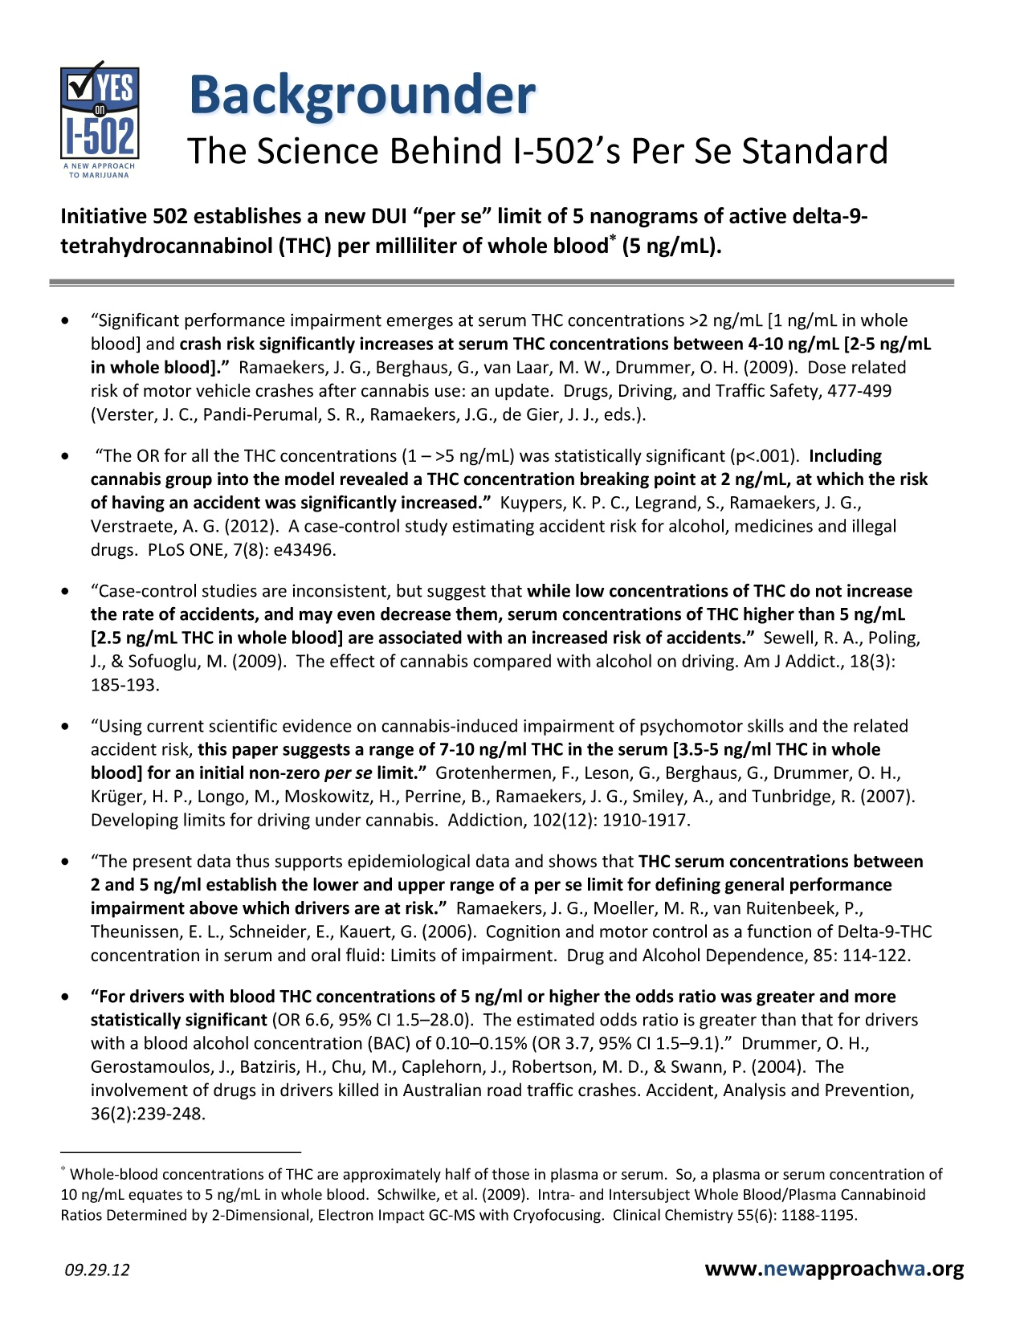

Slide 38
Demographics
Year | Percent Male | Age, Range | Age, Median
2009 | 80 % | 14 - 76 years | 25 years
2010 | 78 % | 15 - 74 years | 25 years
2011 | 81 % | 14 - 70 years | 25 years
2012 | 77 % | 16 - 85 years | 25 years
2013 | 79 % | 14 - 78 years | 26 years

Slide 39
Delta⁹-THC results: Raw data
Year | Total # DUI/DRE cases received for testing | Number of cases positive for THC | Percentage of cases positive for THC
2009 | 4,809 | 877 | 18.2 %
2010 | 5,012 | 974 | 19.4 %
2011 | 5,132 | 1,036 | 20.2 %
2012 | 5,298 | 988 | 18.6 %
2013 | 5,468 | 1,362 | 24.9 %

Slide 40
Carboxy-THC results: Raw data
Year | Total # DUI/DRE cases received for testing | Number of cases positive for carboxy-THC | Percentage positive for carboxy-THC
2009 | 4,809 | 1,267 | 26.3 %
2010 | 5,012 | 1,413 | 28.2 %
2011 | 5,132 | 1,460 | 28.4 %
2012 | 5,298 | 1,515 | 28.6 %
2013 | 5,468 | 2,187 | 40.0 %

Slide 41
THC concentrations (normalized 2009-2012)
Year | # of DUI/DRE cases positive for THC | THC conc. Range (ng/mL) | THC conc. Average (ng/mL) | THC conc. Median (ng/mL)
2009 | 813 | 2 - 73 | 7.6 | 5.8
2010 | 869 | 2 - 58 | 7.2 | 5.3
2011 | 933 | 2 - 58 | 6.9 | 5.3
2012 | 970 | 2 - 90 | 8.1 | 6.3
2013 | 1,362 | 2 - 77 | 7.2 | 5.2

Slide 42
THC concentrations above per se 5 ng/mL
Year | # of DUI/DRE cases positive for THC | # of THC cases BELOW 5 ng/mL | # (%) of THC cases 5 ng/mL or higher
2009 | 813 | 343 | 470 (58%)
2010 | 863 | 403 | 460 (53%)
2011 | 933 | 427 | 506 (54%)
2012 | 970 | 360 | 610 (63%)
2013 | 1,362 | 642 | 720 (53%)

Slide 43
Combined Alc/Drug use in Marijuana cases
 | 2009 | 2010 | 2011 | 2012 | 2013
NEG for alc/drugs | 48 % | 46 % | 50 % | 49 % | 40 %
POS for alc/drugs | 52 % | 54 % | 50 % | 51 % | 60 %

Slide 44
Concentration of Alcohol in Marijuana cases
 | 2009 | 2010 | 2011 | 2012 | 2013
Alcohol NEG | 81 % | 82 % | 82 % | 81 % | 66 %
Alcohol POS | 19 % | 18 % | 18 % | 19 % | 34 %

Slide 45
Other drug use in Marijuana cases
 | 2009 | 2010 | 2011 | 2012 | 2013
Methamph. | 116 (9%) | 184 (13%) | 156 (11%) | 190 (13%) | 253 (12%)
Alprazolam | 86 (7%) | 80 (6%) | 90 (6%) | 80 (5%) | 118 (5%)
Oxycodone | 92 (7%) | 90 (6%) | 62 (4%) | 59 (4%) | 92 (4%)
Diazepam | 75 (6%) | 71 (5%) | 66 (5%) | 53 (4%) | 56 (3%)
Methadone | 60 (5%) | 66 (5%) | 58 (4%) | 54 (4%) | 60 (3%)
Morphine | 50 (4%) | 49 (4%) | 54 (4%) | 66 (4%) | 102 (5%)

Slide 46
Zolpidem and Driving

Slide 47
Zolpidem
Benzodiazepine hypnotic
CNS Depressant
Primarily used for the treatment of insomnia
Ambien
FDA approved for use in 1992
2013 FDA changed the recommended dosage
Controlled release medication
Notes:
2007 – patent expired, sold by 13 different companies
FDA is also warning that patients who take the sleep medication zolpidem extended-release (Ambien CR)―either 6.25 mg or 12.5 mg―should not drive or engage in other activities that require complete mental alertness the day after taking the drug because zolpidem levels can remain high enough the next day to impair these activities. This new recommendation has been added to the Warnings and Precautions section of the physician label and to the patient Medication Guide for zolpidem extended-release (Ambien CR).
Also included in the updated label are the dosing recommendations previously stated in FDA’s January 2013 Drug Safety Communication³: The recommended initial dose of certain immediate-release zolpidem products (Ambien and Edluar) is 5 mg for women and either 5 mg or 10 mg for men. The recommended initial dose of zolpidem extended-release (Ambien CR) is 6.25 mg for women and either 6.25 or 12.5 mg for men. If the lower doses (5 mg for immediate-release, 6.25 mg for extended-release) are not effective, the dose can be increased to 10 mg for immediate-release products and 12.5 mg for zolpidem extended-release. However, use of the higher dose can increase the risk of next-day impairment of driving and other activities that require full alertness.

Slide 48
Pharmocokinetics
Rapidly absorbed – starts to work within 15 minutes
Half life: 2-3 hours
No active metabolites
Duration of effects: 6-8 hours
 | 5 mg | 10 mg | 12.5 mg CR
Cmax (mg/L) | 0.059 | 0.121 | 0.134
Range (mg/L) | 0.029 - 0.113 | 0.058 - 0.272 | 0.069 - 0.197
Baselt, Disposition of Toxic Drugs and Chemicals in Man
Notes:
Studies have indicated no effect the morning after night time administration.
1.6 hr to peak concentration
Recognition of a threshold blood level that would lead to concern about driving allowed assessment of other dosage forms of zolpidem in order to determine what doses would pose a risk of morning driving impairment. In some patients — particularly women, who clear zolpidem more slowly than men — blood levels the morning after taking the recommended bedtime doses could be considerably higher than 50 ng per milliliter. Reanalysis of data from studies of immediate-release zolpidem products showed that 8 hours (i.e., a typical period of sleep) after taking 10 mg of an immediate-release zolpidem product, 15% of women and 3% of men still had blood zolpidem levels of 50 ng per milliliter or higher; when a modified-release higher-dose (12.5 mg) product was taken, the percentages were much higher — 33% of women and 25% of men. These findings, consistent with the sex difference observed with the sublingual low-dose product (Intermezzo), prompted the Food and Drug Administration (FDA) earlier this year to revise the dosing recommendations for the labels of zolpidem-containing products to lower doses, particularly for women.2,3
Controlled release -

Slide 49
Effects of zolpidem
Sedation
Dizziness
Motor incoordination
Adverse effects:
Headache
Nausea
Amnesia

Slide 50
Signs and symptoms
Lack of balance
Unsteady gait
Poor or slow coordination
Slow or slurred speech
Appear tired/drowsy
Disoriented
Short term memory loss
Poor performance on SFSTs (HGN present)
Muscle flaccidity
Sleep driving: Sleepwalking variant or misuse of z-drugs? Pressman MR. Sleep Medicine Reviews 2011;1-8; Zolpidem and driving impairment. Logan and Couper. JFS 2001;46(1):105-110

Slide 51
DRE indicators
28 cases: 11 M and 17 F
Zolpidem only drug detected: 0.05 – 0.69 mg/L (average 0.22 mg/L)
HGN: 6 clues (21), 4 clues (5), 2 clues (2)
VGN: 13
Lack of convergence: 28
Body Temperature: Average 97.0 (95.4 – 101.2)
Chuck Hayes – Zolpidem and Driving – A Dangerous Mix

Slide 52
Driving behaviors
Hitting stationary objects
Lane deviation
Tires over curb
Speed varying from posted limit
Hitting other vehicles
Zolpidem and traffic safety – the importance of treatment compliance. Verster et al. Current Drug Safety 2007;2: 220-226.
Notes:
21 zolpidem only cases from WI. 52, 52, 33, 38, 24%

Slide 53
Sleep driving
Driving while asleep or not fully conscious
Variant of sleep walking
More likely to occur when:
Higher dose is taken, or in combination with other drugs
Following sleep deprivation or stress
Have a history of sleepwalking

Slide 54
Sleep driving vs Impaired by zolpidem
Sleep driving:
Severe cognitive impairment: unable to interact with law enforcement, perform SFSTs or demonstrate comprehension
Near normal physical function: can remain steady, walk, stand up
Impaired by zolpidem
Varying degree of cognitive impairment: but does respond to requests
Severe physical impairment: flaccid muscle tone, lack of balance and steadiness
Sleep driving: Sleepwalking variant or misuse of z-drugs? Pressman MR. Sleep Medicine Reviews 2011;1-8
Notes:
Pressman
Could exit the sleep driving into just sleep impairment

Slide 55
Other toxicology topics
Assumptions for retrograde and Widmark calculations
Synthetic drugs
Spice – synthetic cannabinoids
Bath salts – synthetic cathinones
Court issues

Slide 56
Questions
Brianna Peterson
206-262-6100
brianna.peterson@wsp.wa.gov

